Slide 1
Using Big Data Tools for Race Identification
Miles Franklin, Cliff Mbah, Sayyora Otoboeva

Slide 2
Project Goals
Goal #1:
Create a Decision Tree Classifier that accurately predicts race as a category
Goal #2 (Time permitting):
Implement Goal #1 in a video format
This will require Tensorflow object detection and may require an additional model
Goal #3 (Time permitting):
Implement Goal #2 in with Real-Time learning
Improving Velocity of Learning

Slide 3

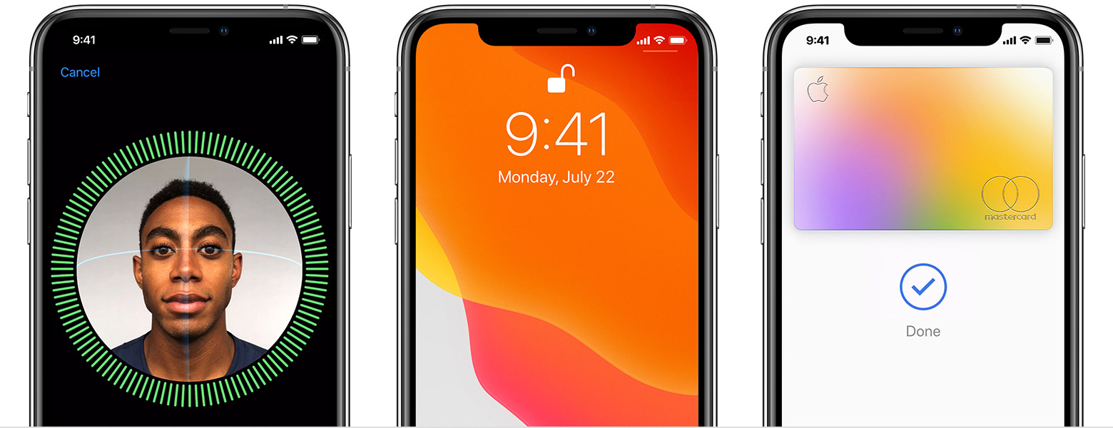
Motivation (Reformat)
Forensic Toolkit (FTK), used mostly by police for making certain predictions and investigation based on image
Mobile Technology is becoming increasingly dependent on Face Identification as a security feature
Notes:
Apple Image: https://support.apple.com/en-us/HT208109
FTK Image: https://forensicstore.com/product/forensic-toolkit-6-2/
FTK Feature: “Similar face and object detection allow investigators to quickly locate all images of a person or object across the case without having to train the system, which can use up valuable time and resources. Also, upload an image from outside the case and compare it to pictures within the current case without ingesting it.”

Slide 4
Project Architecture
Data Collection
Data Storage
Decision Tree Classifier
Expected Result
Additional Goals
Web scrape Google Images for portraits by race. (Black, White, Asian, Latino)
Store into MongoDB using pymongo.
Use sklearn Decision Tree Classifier to train image classifier. Target will be race.
Create a machine learning model that accurately can predict the race of a portrait.
Tensor Flow - Implement so that it can be run in video (ML model to identify if portrait that then triggers ML model to identify race)
Notes:
Decision Tree Classifier: sklearn.tree.DecisionTreeClassifier — scikit-learn 0.23.2 documentation
Tensor Flow: Object detection

Slide 5





Project Architecture con’t
Data Storage
Expected Result
Data Collection
Decision Tree
Additional Goals
Notes:
Decision Tree Classifier: sklearn.tree.DecisionTreeClassifier — scikit-learn 0.23.2 documentation
Tensor Flow: Object detection
The goal is to demonstrate knowledge of Big Data as a field, and leverage some of the commonly used tools for a project
MongoDB Image: https://1000logos.net/mongodb-logo/
Python Logo Image: https://1000logos.net/python-logo/
Spark Logo Image: http://spark.apache.org/docs/1.6.2/api/python/index.html#
Jupyter Logo Image: https://morioh.com/p/727748031e25
Tensor Logo Image: https://www.tensorflow.org/
Additional Libraries to be used:
Beautifulsoup from BS4
Requests
PyMongo
PySpark

Slide 6
Data
Data set will be built from web scraping Google Images
Training data size to be determined
Queries will be “African American Portraits”, “Latino Portraits”, etc.
American Indian, Asian, Black, Latino, Native Hawaiian, White
“Cleaning” will be human collaboration to make sure the data is an accurate target label for each photo
Notes:
Race categories: https://grants.nih.gov/grants/guide/notice-files/not-od-15-089.html

Slide 7
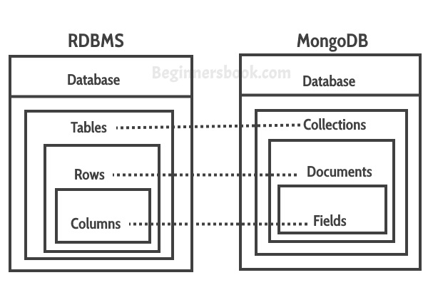
MongoDB Architecture
Collections
Race
Documents
Image File
Fields
Source URL
Target Label (Race)
Image Data
Note: Files are images (>16Mb) and will be broken up using GridFS
Notes:
Image: https://beginnersbook.com/2017/09/mapping-relational-databases-to-mongodb/
GridFS: https://docs.mongodb.com/manual/core/gridfs/

Slide 8
Expected results
As we introduce more races for the model to classify, the accuracy will likely decline
It will be a challenge to figure out what a decent sample size would be
Will likely start with a sample of ~50 images per race and adjust as needed
The model may experience high recall and low precision for groups of color, while it may perform high in both scores for categorizing white portraits.

Slide 9
The 6 V's of Big Data
Volume
Velocity
Variety
Using MongoDB to store a scalable data set of images.
Time permitting, would like to deploy this model in a vide setting,. This would require an additional model to first identify a portrait from a video.
This will be a semi structured dataset. Images will likely have a variable number of pixels.
1
2
3

Slide 10
The 6 V's of Big Data con’t
Variability
Veracity
Value
Handling anomalies in the data. Google Images is not always predictable and may require human collaboration to validate training data is useful.
Varying degrees of facial recognition is highly integrated in today’s technology, from smart phone security, to identification tools used by law enforcement.
Unsure, since our project does not stream in data real time as it makes predictions.
4
5
6

Slide 11

Questions
Notes:
Image Source: https://www.machinedesign.com/community/article/21836908/what-questions-should-you-ask-during-the-product-lifecycle

